Slide 1
Ray Tracing from the Top Down
Apollo Ellis

Slide 2
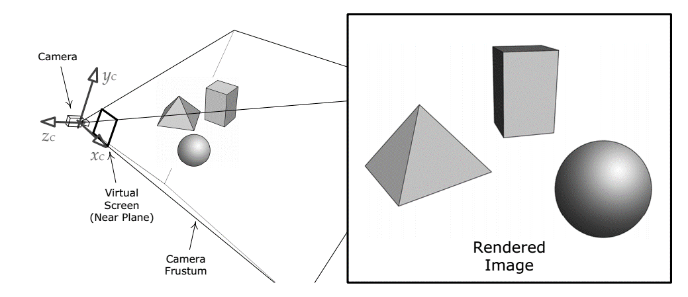
Rendering
Camera
Scene
Light
Image

Slide 3
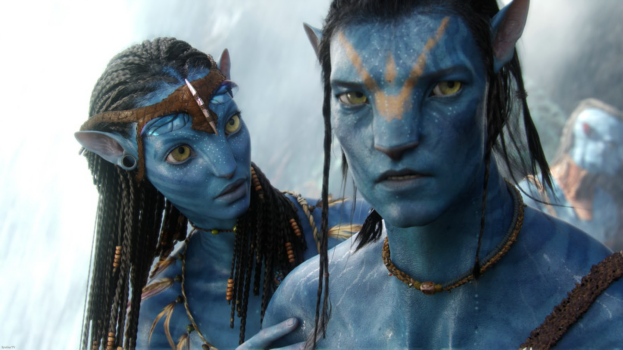
Holy Grail
Holy grail is:
Ray tracing
Full global illumination
In real time
Avatar

Slide 4
Light transport is complex
How many photons of light are in this scene?
Where do they go?
Direct: through the air
Reflection: in their eyes
Refraction: in their skin
Absorbed: also in their skin
Scattering: through the fog
Bouncing: everywhere
Observation photons move like geometric rays

Slide 5
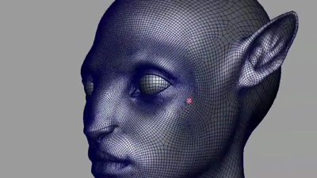
What does the model look like?
How many polygons do we need?
Micro polygons are the holy grail
Subpixel size polygons (usually triangles)
N = ~8,000,000 for one scene
What about a whole world?
Every surface must be modeled
That’s a lot of polygons

Slide 6
Counting
We have a lot of photons
Photons bounce off surfaces
We have a lot of surfaces
Surfaces are very complex
Just like in avatar we have a camera
Which photons hit the camera and which surfaces did they hit?
Now we need to trace rays i.e. Ray Trace

Slide 7
Ray Tracing is complex
How many rays?
VR is asking for 75Hz on 4K
Remember we want real time
8,000,000 million pixels
One ray per photon
64 photons per pixel
75 times a second
38 billion rays per second!

Slide 8
How fast was avatar?
~47 hours per still frame
~50-100 computers in parallel
Even if you don’t care about real time
You have a big problem!

Slide 9
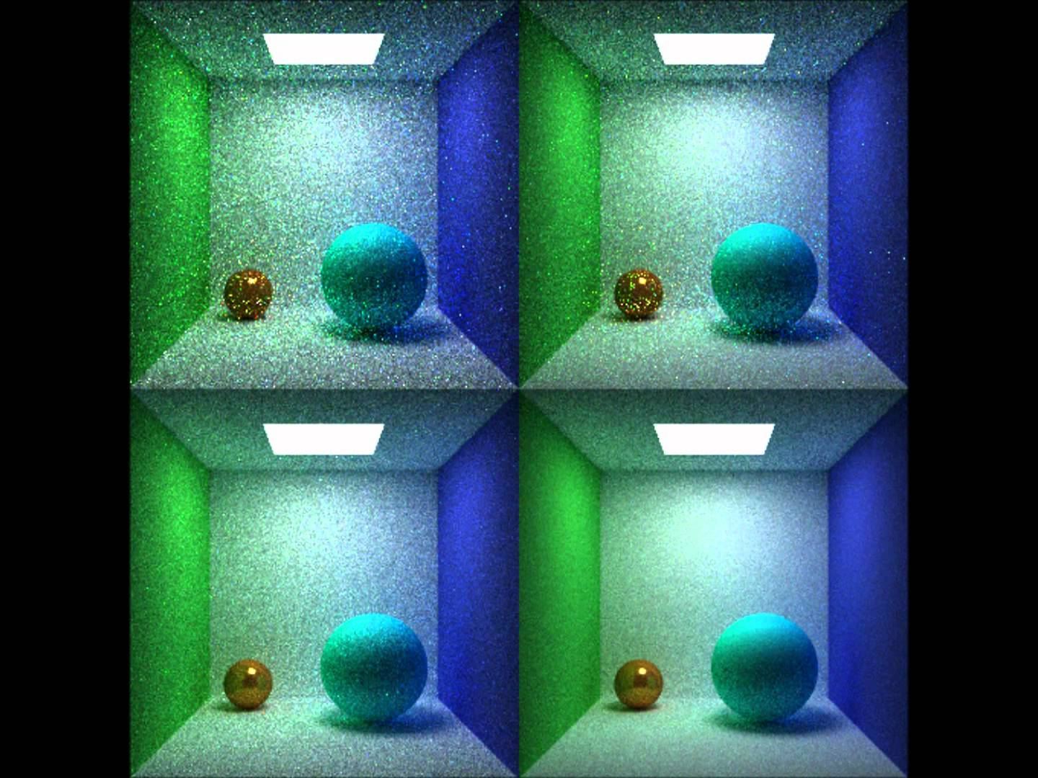
Case Studies: Monte Carlo path tracing
Monte Carlo integration
Shoot rays into the scene
Bounce rays in random directions
Weight bounce by probability density
Stop when hit a light source
Eventually the picture will converge

Slide 10
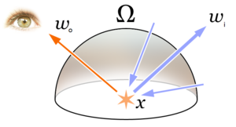
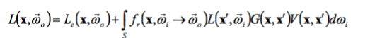
Solving the rendering equation
We are shooting rays from the eye
But it doesn’t matter
We could shoot them from the light
We could shoot them from the scene
We just need to find paths of light
We just need to shoot rays

Slide 11
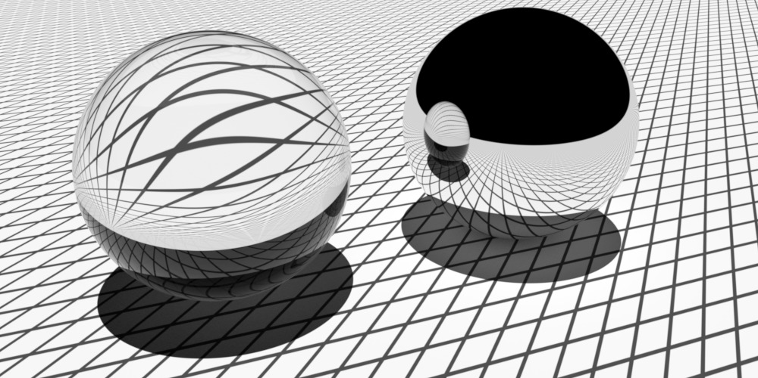
Case Studies: Basic Reflection

Slide 12
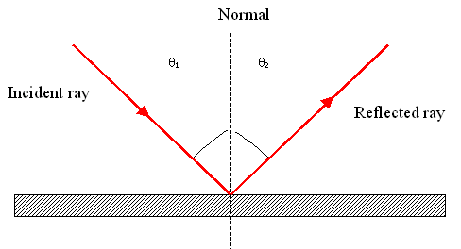
Reflection

Slide 13
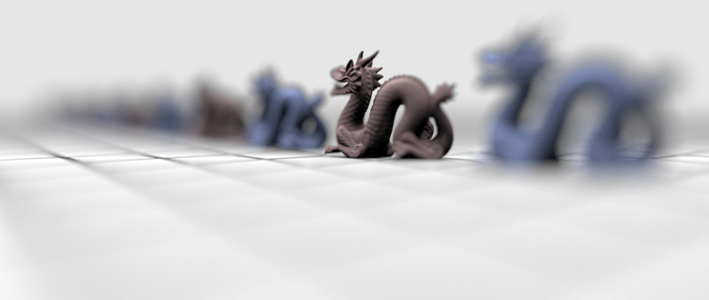
Case Studies: Depth of Field

Slide 14
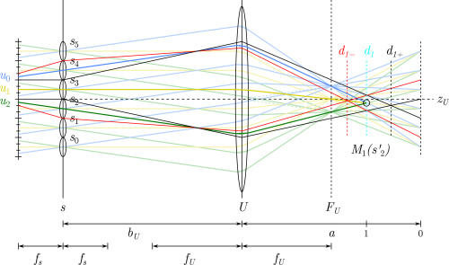
Distribution Based Ray Tracing
We want to model a lens
A lens will focus many rays to one pixel
So we need to shoot a lot of rays
We distribute them over the lens
Don’t worry about the diagram
We just need to shoot a lot of rays

Slide 15
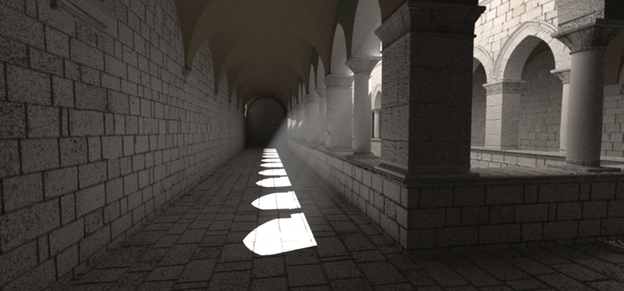
Case Studies: Shadows

Slide 16
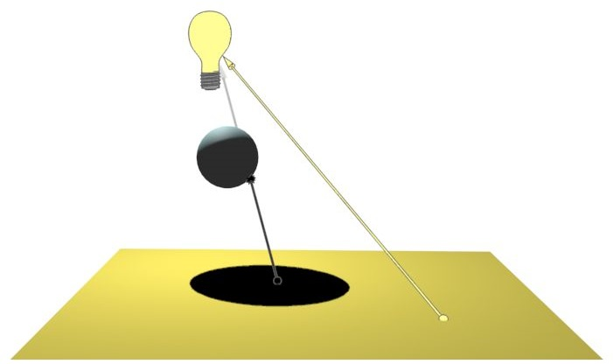
Shooting Shadow Rays

Slide 17
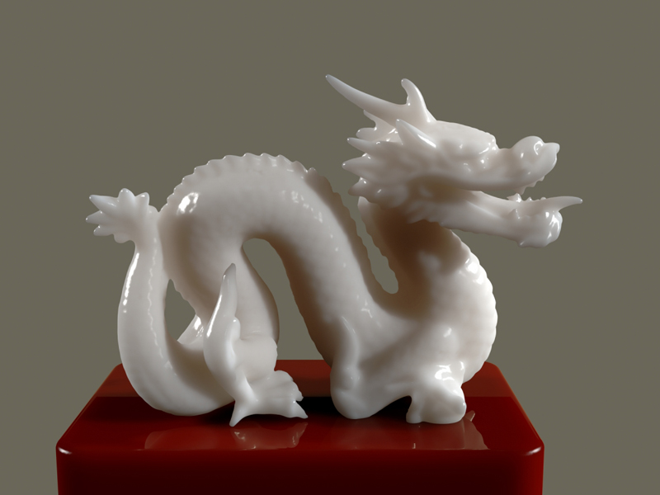
Case Studies: Subsurface Scattering

Slide 18
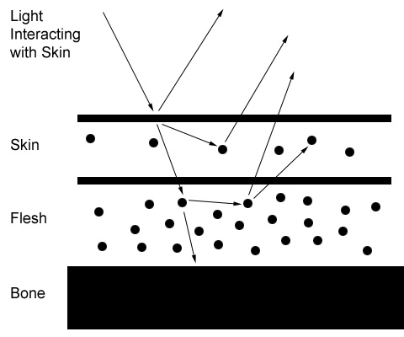
Rays can transmit in skin and back out

Slide 19
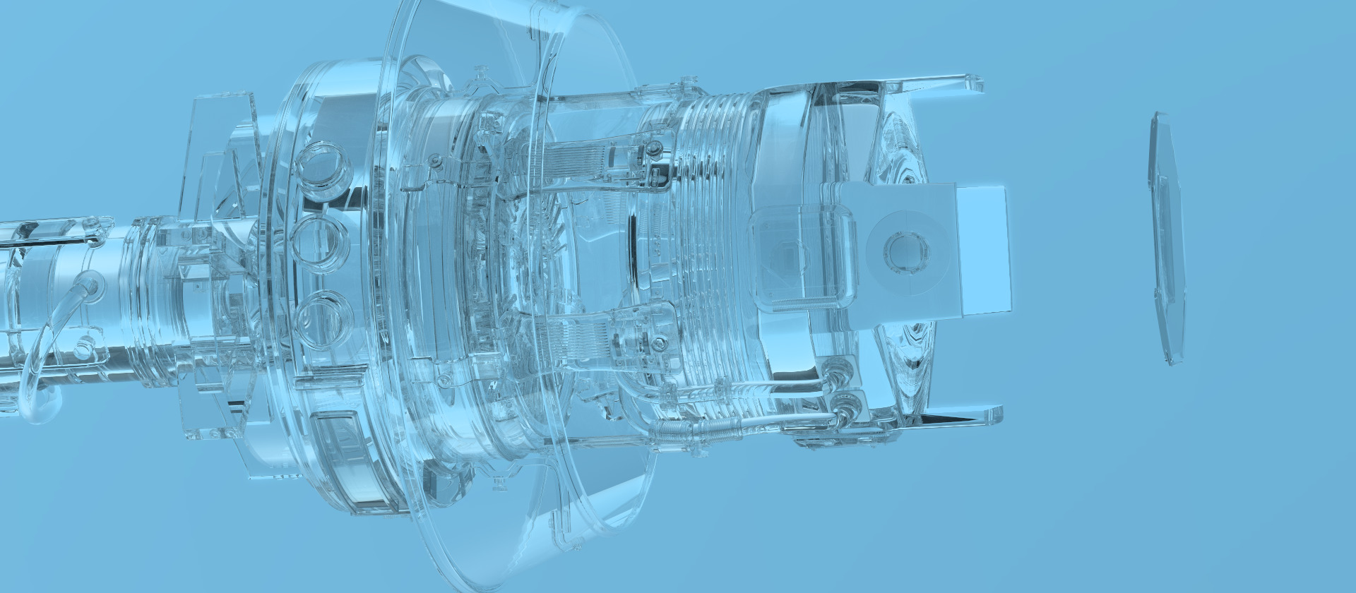
Case Studies: Refraction

Slide 20
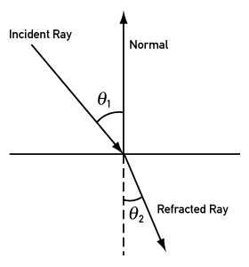
Refraction Rays

Slide 21
So you wrote a ray tracer?
My first ray tracer was parallel
My first ray tracer was optimized
My first ray tracer was slow!
Ray tracing is O(N^2)
For all the rays per pixel
For all the surface geometry
Check for hits
How can we mitigate the cost?

Slide 22
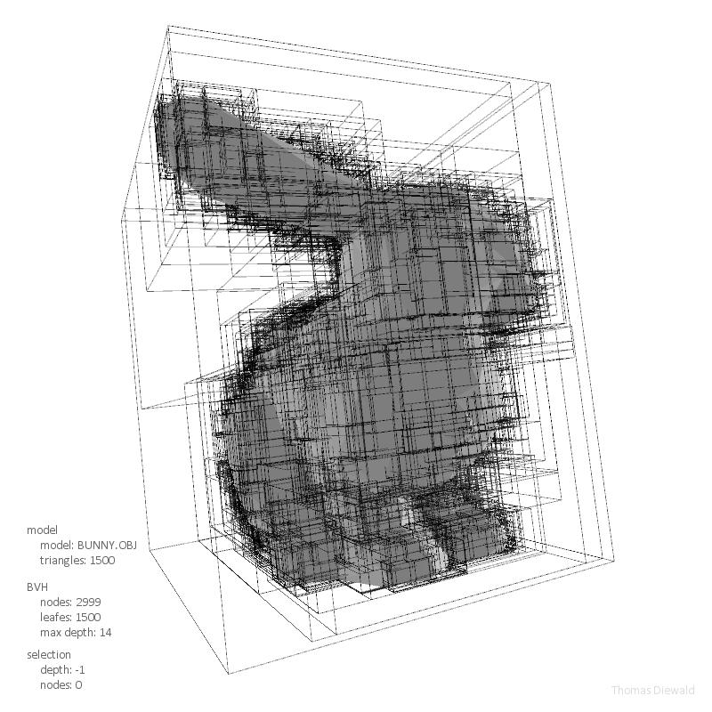
Acceleration Structures: BVH
Bounding Volume Hierarchies (BVH)
Separate the scene into small scenes
Provide a bounding volume for each
Divide and Conquer
Hierarchical Structure

Slide 23
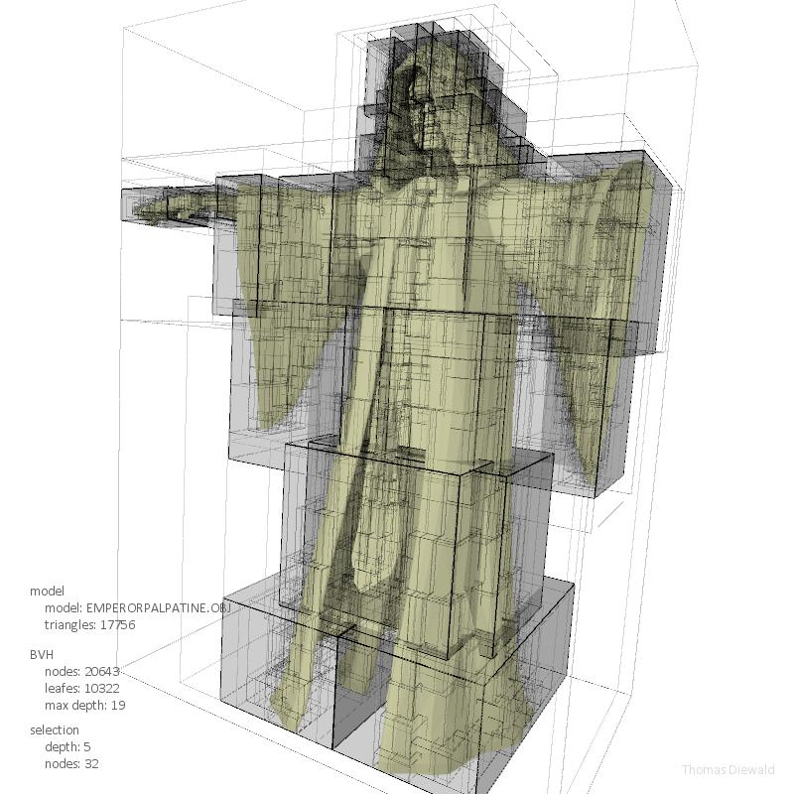
Acceleration Structures: BVH
Bounding Volume Hierarchies (BVH)
Separate the scene into small scenes
Provide a bounding volume for each
Divide and Conquer
Hierarchical Structure

Slide 24
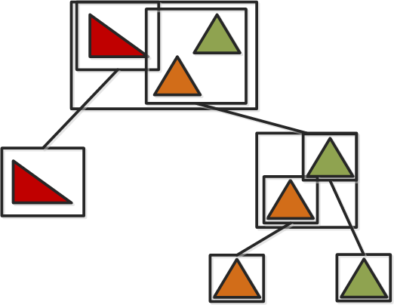
Acceleration Structures: BVH
Bounding Volume Hierarchies (BVH)
Separate the scene into small scenes
Provide a bounding volume for each
Divide and Conquer
Hierarchical Structure

Slide 25
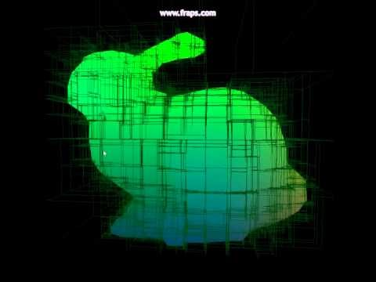
Acceleration Structures: KD Tree

Slide 26
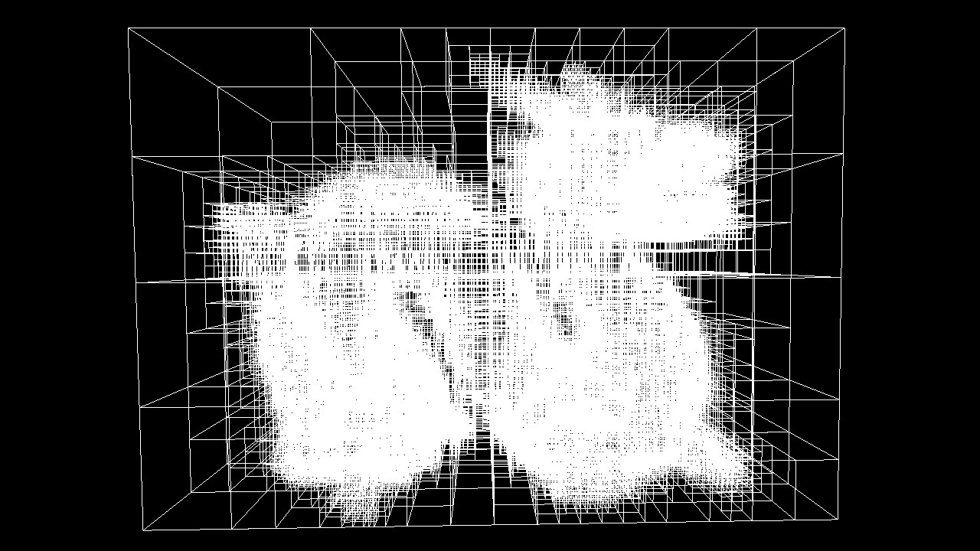
Acceleration Structures: KD Tree
KD Tree
Another hierarchy
Most important idea is splitting
How to get find good split
Cost to split vs Cost to not
Construction is O(N^2)
Too slow
Use sorting to achieve N(log(N))

Slide 27
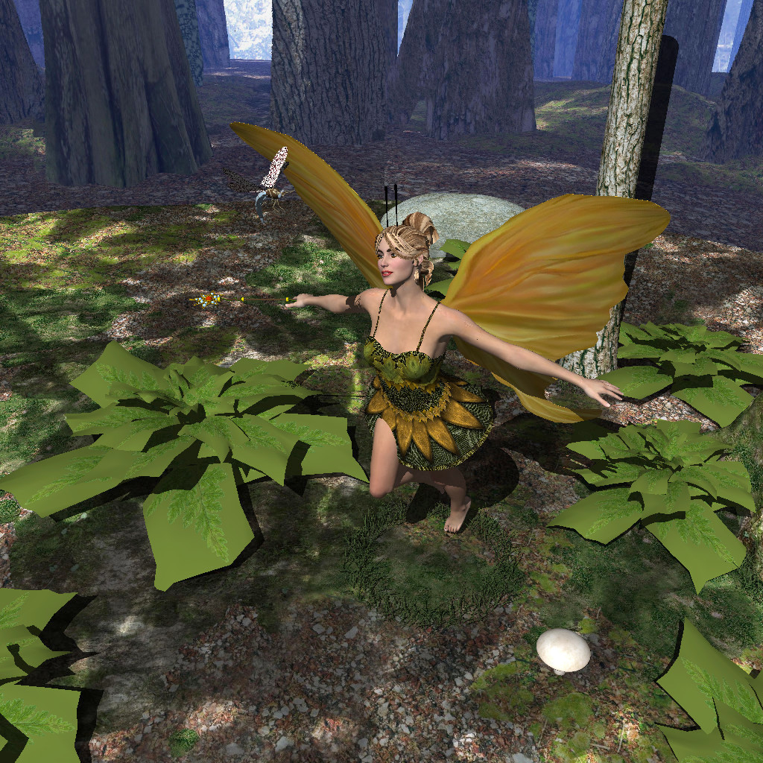
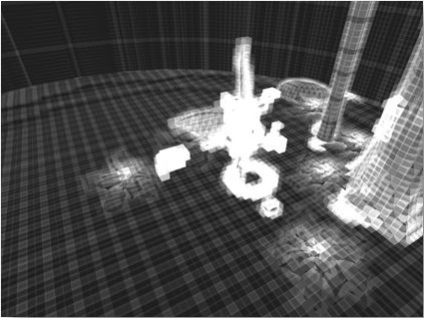
Acceleration Structures: Uniform Grid
Simple structure
Fast to build
Suffers load imbalance
Teapot in Stadium

Slide 28
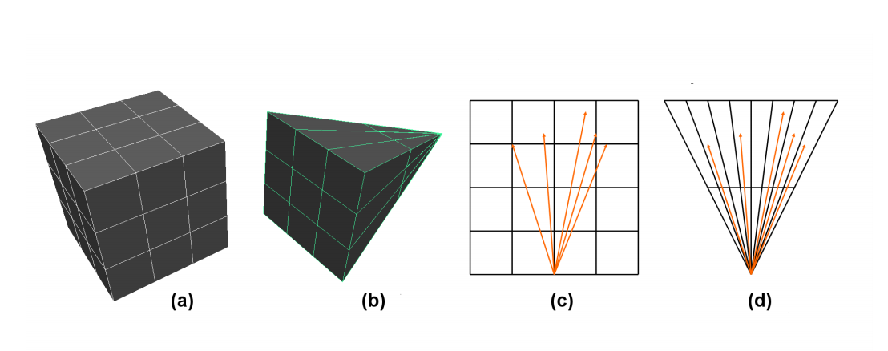
I only care about special types of rays
Perspective

Slide 29
I only care about special types of rays
Perspective grid
Use 4 dimensional warping
Simplify the math
Speed can reach GPU level for special cases
First generation rays (Eye rays or Visibility)
Shadows

Slide 30
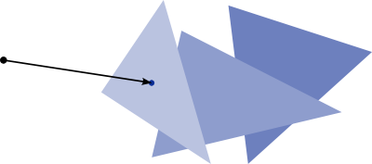
What are we doing again? Ray Triangle intersection
All this time we’ve been shooting rays at triangles.
How do we actually intersect a ray and triangle?
A simple algorithm
Intersect ray with triangle plane
Use cross products
Check if the point is inside each edge

Slide 31
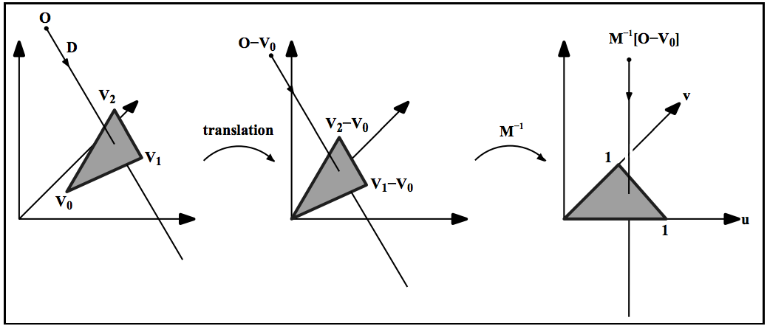
Advanced Ray Triangle Intersection
One trick pony
Get the problem into 2D
Badoule – simple projection
Wald – precomputed and fast
Shevtsov – plücker based
Möller Trumbore – no storage
Woop et al. – fastest/latest

Slide 32
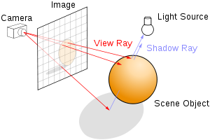
Ray tracing
Define a geometric scene
Define a view point
Define a screen
1. Shoot rays from the view point
2. Through the screen
3. Intersect with the scene
4. Bounce around until you hit a light
Everything else falls out

Slide 33
GPU Ray tracing
External slide… Intersection B

Slide 34
It’s still not fast enough! Ray Tracing Hardware
Caustic built a Ray Tracing GPU
Imagination bought caustic
The GPU is on the market and nobody knows
Samsung researchers built a Ray Tracing GPU
It was research for ~5 years
It was eventually canceled
An Austin based researcher solved the economic problem
Ray tracing HW using 1bit of precision

Slide 35
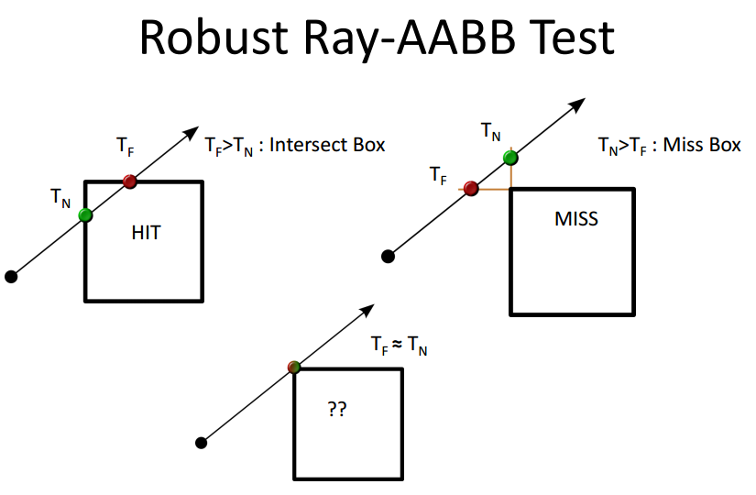
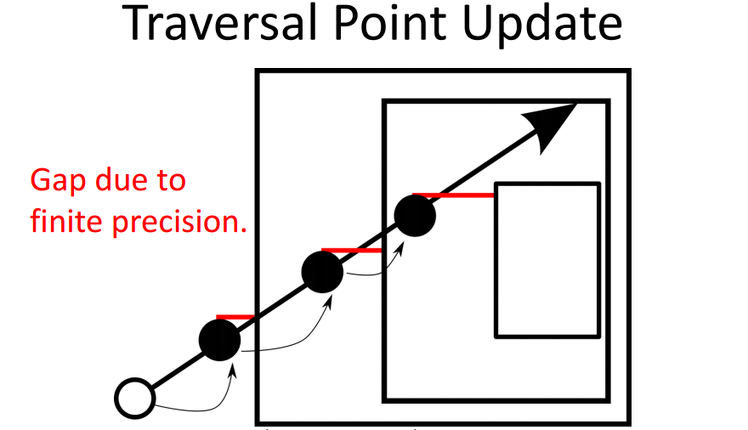
RTHW Continued - Precision

Slide 36
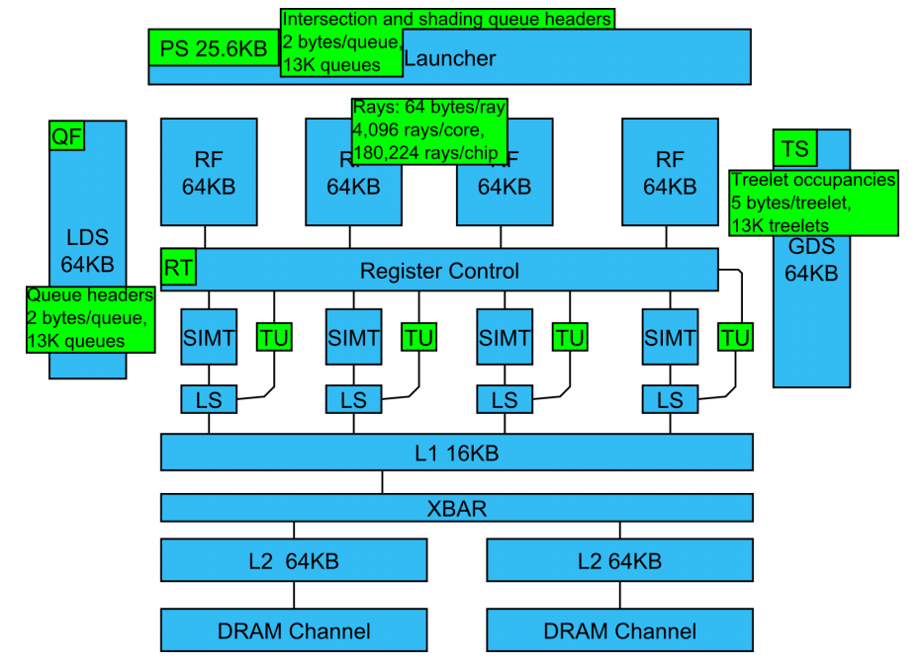
Ray tracing now fits in current GPUs

Slide 37
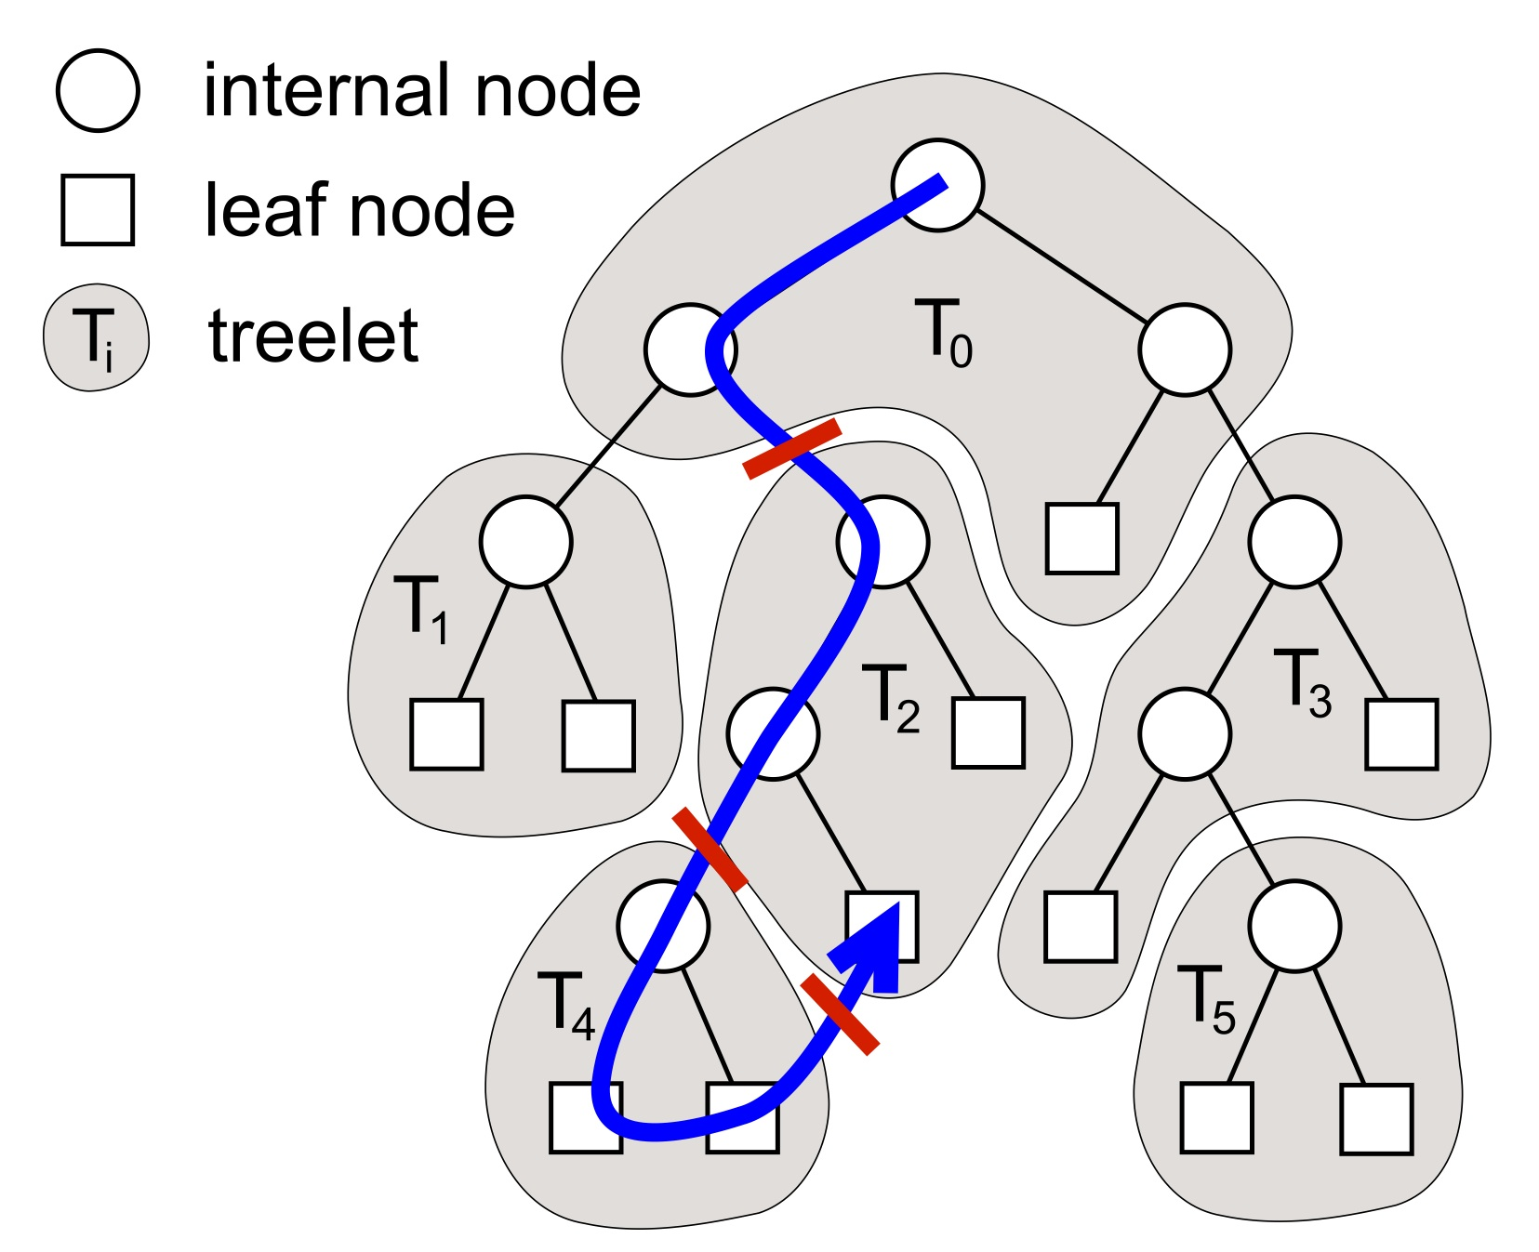
RTHW Continued - Bandwidth
When many rays collected
Bind treelet/queue to processor(s)
Amortizes scene transfers
Repeat until done
Rays queue up and request treelets
Keely ‘14 uses a no hit cache policy
Separate scheduler manages cache

Slide 38
Ray tracing from the top down
Think about the goal
What is the holy grail?
What are the building blocks
What are the low level details
Sometimes solution is low level
Still so much work to do

